Slide 1
PLAY NOW

Slide 2
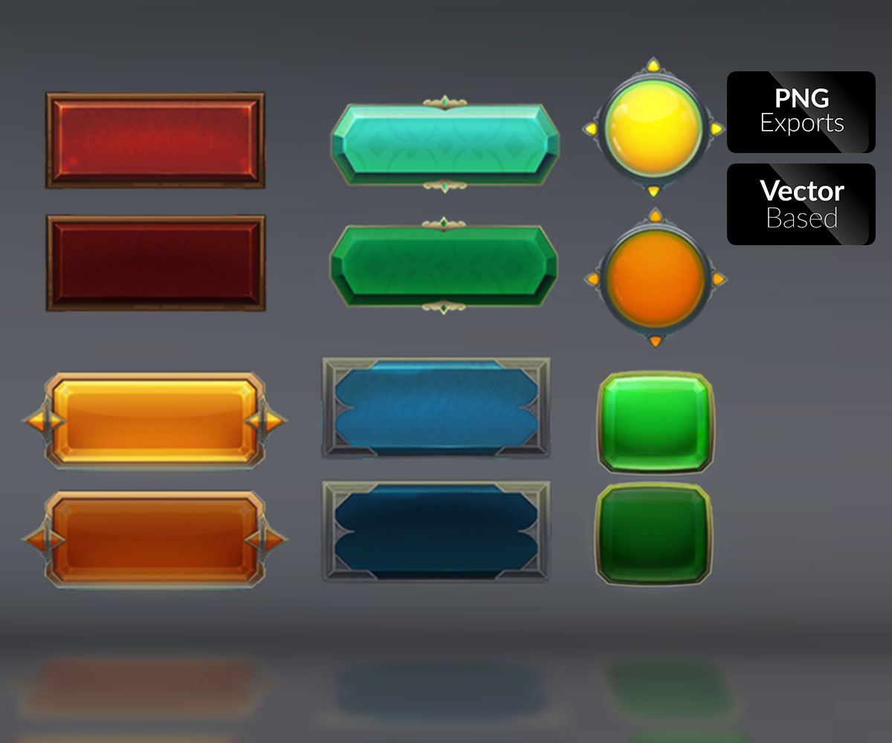
SAVE
RESTART
LOAD GAME
NEW GAME
EXIT

